Slide 1
Query Processing Hashing and Aggregation
Background Knowledge for Project 2
Notes:
Slides borrowed from CS143 Sp 2017 and revised (jteoh)

Slide 2
Announcements
HW grades released up to HW3 (4 soon)
Project 2: Friday Dec 8 @ 11:59PM
re-download package.sh if you haven’t already
Check Piazza when stuck
HW6: Wednesday Dec 6 @ 11:59PM
Final exam: Monday Dec 11 @ 8AM-11AM
location TBD, check course registrar
Course evaluations now available online
Notes:
Reminder: hw not worth as much of the grade and we grade based on effort. If you’re stuck at least put down some thoughts as opposed to leaving it blank... but do focus on the project since it’s worth far more (19% vs 1%)

Slide 3
Origin Slides From: Introduction to Databases Query Processing and Optimisation Prof. Beat Signer

Slide 4
Relational Operator - Iterator
The relational operators are all subclasses of the class iterator:
class iterator { void init(); tuple next(); void close(); iterator inputs[];
// additional states }
Note:
Edges in the graph are specified by inputs (max 2, usually)
Encapsulation: any iterator can be input to any other!
When subclassing, different iterators will keep different kinds of state information
iterator

Slide 5
Example: Projection Scan
class Scan extends iterator { void init(); tuple next(); void close();
List<Attribute> proj_list; iterator inputs[1]; }
init():
Set up internal state
call init() on child – often a file open
next():
call next() on child until qualifying tuple found or EOF
keep only those fields in “proj_list”
return tuple (or EOF -- “End of File” -- if no tuples remain)
close():
call close() on child
clean up internal state

Slide 6
Streaming through RAM
How to transform input tuples (on Disk) to output tuples (on Disk)?
Simple case: “Map”. (assume many records per disk page)
Goal: Compute f(x) for each record, write out the result
Challenge: minimize RAM, call read/write rarely
Approach
Read a chunk from INPUT to an Input Buffer
Write f(x) for each item to an Output Buffer
When Input Buffer is consumed, read another chunk
When Output Buffer fills, write it to OUTPUT
Reads and Writes are not coordinated (i.e., not in lockstep)
E.g., if f() is Compress(), you read many chunks per write.
E.g., if f() is DeCompress(), you write many chunks per read.
Input
Buffer
Output
Buffer
INPUT
f(x)
Disk
OUTPUT
Disk
RAM

Slide 7
Rendezvous
Streaming: one chunk at a time. Easy.
But some algorithms need certain items to be co-resident in memory
not guaranteed to appear in the same input chunk
Time-space Rendezvous
in the same place (RAM) at the same time

Slide 8
Divide and Conquer
Out-of-core (external memory) algorithms orchestrate rendezvous.
Typical RAM Allocation:
Assume B pages worth of RAM available
Use 1 page of RAM to read into
Use 1 page of RAM to write into
B-2 pages of RAM as workspace
B-2
INPUT
OUTPUT
Disk
Disk
IN
OUT

Slide 9
Divide and Conquer
Phase 1
“streamwise” divide into N/(B-2) megachunks
output (write) to disk one megachunk at a time
B-2
INPUT
OUTPUT
Disk
Disk
IN
OUT

Slide 10
Divide and Conquer
Phase 2
Now megachunks will be the input
process each megachunk individually.
B-2
OUTPUT
Disk
Disk
IN
OUT

Slide 11
Example: Hashing
Idea:
Many times we don’t require order
E.g.: removing duplicates
E.g.: forming groups
Often just need to rendezvous matches
Hashing does this
And may be cheaper than sorting! (Hmmm…!)
But how to do it out-of-core (externally)??
Notes:
ex: a hash join

Slide 12
Divide
Streaming Partition (divide): Use a hash function h_{p} to stream records to disk partitions
All matches rendezvous in the same partition.
Streaming algorithm to create partitions on disk:
“Spill” partitions to disk via output buffers

Slide 13
Divide & Conquer
Streaming Partition (divide): Use a hash function h_{p} to stream records to disk-based partitions
All matches rendezvous in the same partition.
Streaming algorithm to create partitions on disk:
“Spill” partitions to disk via output buffers
ReHash (conquer): Read partitions into RAM-based hash table one at a time, using hash function h_{r}
Then go through each bucket of this hash table to achieve rendezvous in RAM
Note: Two different hash functions
h_{p} is coarser-grained than h_{r}

Slide 14
Two Phases
Original
Relation
OUTPUT
Partitions
1
1
INPUT
2
hash
function
h_{p}
2
Partition:
. . .
B-1
B-1
Disk
B main memory buffers
Disk

Slide 15
Two Phases
Original
Relation
OUTPUT
Partitions
1
1
INPUT
2
hash
function
h_{p}
2
Partition:
Rehash:
. . .
B-1
B-1
Disk
B main memory buffers
Disk
Partitions
Result
Hash table for partition
R_{i} (k <= B pages)
hash
fn
h_{r}
Disk
B main memory buffers

Slide 16
Hashing Summary
Hashing:
Pass 1 uses coarse-grained hash function to produce B-1 partitions
Pass 2 loads each partition into memory, rehashes them, and writes them out to disk (or probes them for hash join).
Any partition of size > B must be repartitioned (repeat step 1)
In 2 passes, sort B(B-1) pages of data

Slide 17
Aggregation
SELECT COUNT(*) FROM Students;
How could we answer this query?
Scan…
Use an index?
System catalog

Slide 18
Aggregate Operations (AVG, MIN, etc.)
Without grouping:
In general, requires scanning the relation.
Use Index Scan if possible …
With grouping:
Sort on group-by attributes, then scan relation and compute aggregate for each group. (Better: combine sorting and aggregate computation.)
Similar approach based on hashing on group-by attributes.
Use Index Scan if possible …
Notes:
20

Slide 19
Hash GROUP BY: Naïve Solution
Aggregate
Hash
The Hash iterator permutes (re-organizes) its input so that all tuples are output in groups (sorted by group-by key).
The Aggregate iterator keeps running info (“transition values” or “transVals”) on agg functions in the SELECT list, per group
E.g., for COUNT, it keeps count-so-far
For SUM, it keeps sum-so-far
For AVERAGE it keeps sum-so-far and count-so-far
When the Aggregate iterator sees a tuple from a new group:
It produces an output for the old group based on the agg function
E.g. for AVERAGE it returns (sum-so-far/count-so-far)
It resets its running info.
It updates the running info with the new tuple’s info

Slide 20
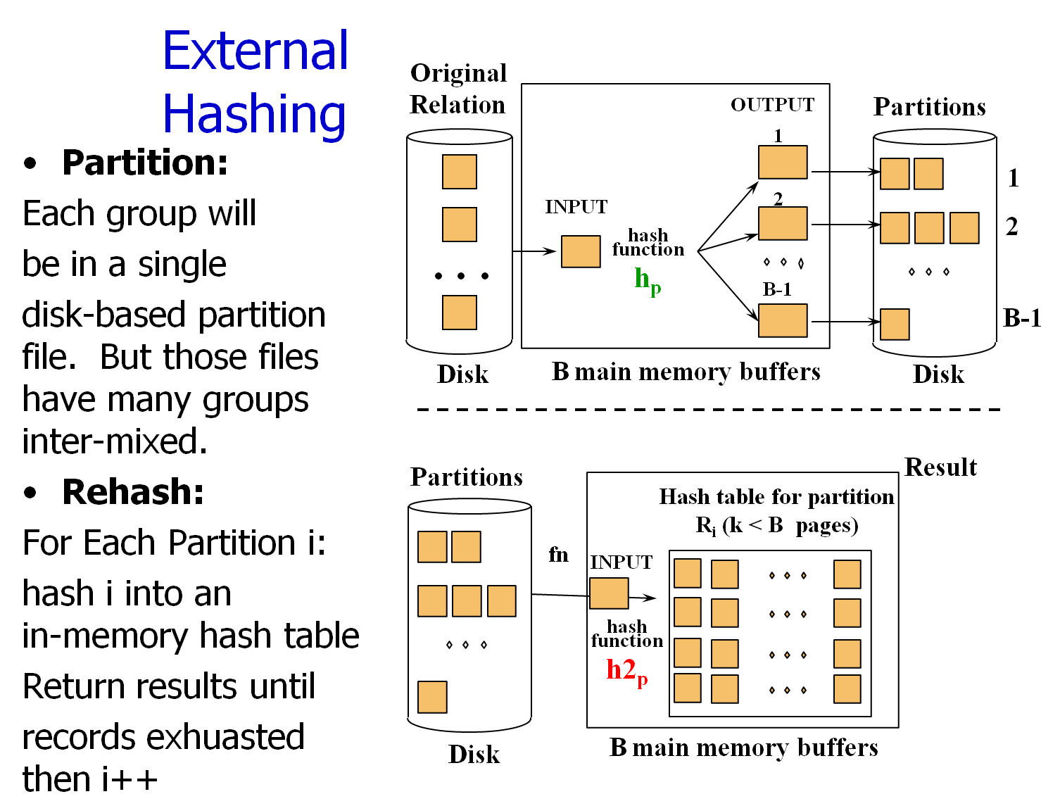

Slide 21
We Can Do Better!
HashAgg
Put summarization into the hashing process
During the ReHash phase, don’t store tuples, store pairs of the form <GroupVals, TransVals>
When we want to insert a new tuple into hash table
If we find a matching GroupVals, just update the TransVals appropriately
Else insert a new <GroupVals,TransVals> pair
What’s the benefit?
Q: How many pairs will we have to maintain in the rehash phase?
A: Number of distinct values of GroupVals columns
Not the number of tuples!!
Also probably “narrower” than the tuples

Slide 22
We Can Do Even Better Than That: Hybrid Hashing
What if the set of <GroupVals,TransVals> pairs fits in memory?
It would be a waste to spill all the tuples to disk and read them all back back again!
Recall <G,T> pairs may fit even if there are tons of tuples!
Idea: keep <G,T> pairs in 1st partition in memory during phase 1! (This partition occupies at most K pages)
Output its stuff at the end of Phase 1.
Q: how do we choose the number of pages (k) to allocate to this special partition?
k-buffer hashtable
of <G,T> pairs
Original
Relation
OUTPUT
Partitions
2
1
2
3
3
. . .
INPUT
h_{h}
B-k
B-k
Disk
B main memory buffers
Disk
Notes:
Want to be careful with size of k-buffer hash table – if all pairs will fit, then make it as big as necessary – else, want to make sure that
the partitions (contain actual tuples) that sent to disk are smaller than B if at all possible.
(As you make k larger, there are less pages in memory, so each hash bucket contains more tuples. When reading it back, if exceeding B,
you need to repeat the hash process again.)

Slide 23
A Hash Function for Hybrid Hashing
Assume we like the hash-partition function h_{p}
Define h_{h} operationally as follows:
h_{h}(x) = 1 if x maps to a <G,T> already in the in-memory hashtable
h_{h}(x) = 1 if in-memory hashtable is not yet full (add new <G,T>)
h_{h}(x) = h_{p}(x) otherwise
This ensures that:
Bucket 1 fits in k pages of memory
If the entire set of distinct hashtable entries is smaller than k, we do no spilling!
Original
Relation
k-buffer hashtable
OUTPUT
Partitions
2
1
2
3
3
. . .
INPUT
h_{h}
B-k
Disk
B main memory buffers
Disk

Slide 24
Example
SELECT seniority, COUNT(*) FROM Students GROUP BY seniority;
How could we answer this query?
Sort, then scan
Scan and keep 4 numbers in memory
Use an index on (seniority)
Use catalogs?
seniority | COUNT(*)
Freshman | 47
Sophomore | 62
Junior | 85
Senior | 70

Slide 25
Hybrid Hashing
Let’s take a look at the “Partition” phase.
Add a hash table.
Instead of writing data to disk, put it in the hash table if there’s room.
Keep running totals for each GroupVal.

Slide 26
Hybrid Hashing - example
Original
Relation
So: 12 Fr: 13 Jr: 8 Sn: 20
OUTPUT
Partitions
1
So
1
INPUT
2
Fr
hash
function
h_{p}
2
. . .
So
B-1
B-1
Disk
B main memory buffers
Disk
So: 12 Fr: 13 Jr: 8 Sn: 20

Slide 27
Hybrid Hashing - example
Original
Relation
So: 13 Fr: 13 Jr: 8 Sn: 20
OUTPUT
Partitions
1
So
1
INPUT
2
Fr
hash
function
h_{p}
2
. . .
B-1
B-1
Disk
B main memory buffers
Disk
So: 13 Fr: 13 Jr: 8 Sn: 20

Slide 28
Hybrid Hashing - example
Original
Relation
So: 14 Fr: 13 Jr: 8 Sn: 20
OUTPUT
Partitions
1
1
INPUT
2
Fr
hash
function
h_{p}
2
. . .
B-1
B-1
Disk
B main memory buffers
Disk
So: 14 Fr: 13 Jr: 8 Sn: 20

Slide 29
Hybrid Hashing - example
Original
Relation
So: 14 Fr: 14 Jr: 8 Sn: 20
OUTPUT
Partitions
1
1
INPUT
2
hash
function
h_{p}
2
. . .
B-1
B-1
Disk
B main memory buffers
Disk
So: 14 Fr: 14 Jr: 8 Sn: 20

Slide 30
Hybrid Hashing – example 2
Original
Relation
Fr: 13 Sn: 20
OUTPUT
Partitions
1
So
1
INPUT
2
Fr
hash
function
h_{p}
2
. . .
So
B-1
B-1
Disk
B main memory buffers
Disk
Continues Sophomores and Junior like normal hashing!
Notes:
This example seems to assume that seniors also fit into the k-buffer hash table

Slide 31
Thanks.

Slide 32
Hybrid Hashing Situation (PJ2)
You have to take care of the situation in which
The input iterator of generateIterator is drained;
2) Aggregate table contains aggregate values for a subset (not all) groups;
3) The remaining groups sit on disk in files properly partitioned

Slide 33
Sort-Agg for GROUP BY
Steps:
Sort
… aggregate “transVals”
Keep a count-so-far
Or an average-so-far
Or a min-so-far…
Whenever we find a tuple from a new group, output the last group’s transVal.

Slide 34
Sort-Agg Refinement
Can we perform the same refinement we did for sort-merge join? (i.e., aggregate during the merge step?)
Yes.

